Slide 1
STREAMING ANALYTICS OF SPORTS RELATED TWEETS USING APACHE SPARK
MSDS 7330

Slide 2
Introduction and General Idea
Twitter --> Share @Speed of Thought
Available for consumption at near real time
Cover a broad section of society on international level
Analyzing the tweets contents, text, followers, friends, retweets many insights can be gained
Graphs that connect people/groups
Things people care about
How they feel
Whom they get influenced
What they generally think

Slide 3
Project Idea
Idea is to analyze popular game in near real time
Gather sentiment or other interesting information using the tweets related to sporting events
In general:
Which players are mentioned the most
Number of tweets that mentioned referees
Search for certain words that indicate positive sentiment about a team
Search for certain words that indicate negative sentiment about a team
Search for any marketing messages included in the tweets
Use the Geo location feature of the tweets to determine the heat map of the areas where the games is the most tweeted about (If possible and available)
Determine the timeline based distribution of number of tweets

Slide 4
Tools and Resources
Many “big data” applications need to act on data arriving in real time
Apache Spark
Cluster computing platform
Fast and general purpose
Extends MapReduce model to support interactive queries and stream processing
Java/Python
Highly capable programming languages
Simple interface to interact with SPARK and Twitter APIs
Database - MySQL/MongoDb/FlatFiles
Highly capable and free databases
MongoDb is good for Document Oriented Data storage and retrieval. JSON like format for document storage
MySQL - Simple and free yet very powerful, SQL query support
Collaboration
GitHub

Slide 5
Environment Setup
Vagrant is used for environment setup
Vagrant provides easy to configure, reproducible, and portable work environments built on top of industry-standard technology
Controlled by a single consistent workflow to help maximize the productivity and flexibility
Say goodbye to "works on my machine" bugs

Slide 6
Project Flow
In any stream processing system, broadly speaking, there are three steps in processing the data.
Receiving the data: The data is received from sources using Receivers or otherwise.
Transforming the data: The received data is transformed using DStream and RDD transformations.
Pushing out the data: The final transformed data is pushed out to external systems like file systems, databases, dashboards, etc.
Receive data streams from input sources, process them in a cluster, push out to databases/ dashboards
SparkContext, pyspark, pymongo, tweepy APIs (in Python)
Java/Python Functions
Dashboards/Analytics
Twitter
Spark Cluster - Spark/SparkStreaming In Memory Computation
DB
Compute and Store cluster

Slide 7
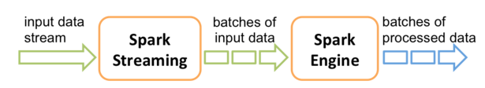
Steps
Create Spark StreamingContext object (1 second or more can be given as an option for stream collection)
Spark Streaming provides a high-level abstraction called discretized stream or DStream, which represents a continuous stream of data
Create Twitter Credentials and OAuth Keys
Establishing the database connection to MongoDb Database for example
Store the incoming tweets or perform on the fly computations using SparkContext
Top 10 Tweets
Top 10 Screen_Names
Top 10 Hashtags

Slide 8
Sample Outputs
Some Analysis and results of a game between CAR vs DAL are shown below:
Tweets Collected in for 3 Half's and stored on Mongodb --> 71403
Top 10 Most Frequent #Terms and normal terms (Excluding stopwords)
[(u'#CARvsDAL', 66448), (u'#Panthers', 8157), (u'#LUUUUKE', 5193), (u'#KeepPounding', 3033), (u'#Cowboys', 2901), (u'#Pick6', 1132), (u'#LUUUUUUKE', 1046), (u'#Picked', 1020), (u'#NFL', 748), (u'#TOUCHDOWN', 707)] [(u'RT', 109660), (u'\ud83d', 26682), (u'Romo', 17458), (u'6', 15706), (u'Tony', 13614), (u'\u2026', 11710), (u'Newton', 11424), (u'Luke', 10644), (u'Dab', 9458), (u'30', 9436)]
Top retweeted Tweets:
"Who wants to name this dance because we have no idea. \n\n#Panthers up30-6! #CARvsDAL https://t.co/nnAN6mvJAM",
"Dab Newton scores.\n\nDab Newton dances. #CARvsDAL \n\n https://t.co/mrM8xLdfZh",
"Don't test him!! \n\nAnother interception for #LUUUUKE! #CARvsDAL https://t.co/E8AEn8Uc6N",
"Who's ready?!?! #CARvsDAL https://t.co/VAPdp7IbgE",
"Three hours until kickoff! #DabOnThemTurkey #CARvsDAL https://t.co/tSJLHzuDuU"
Top 2-Words together
((u'\ud83d', u'\udd25'), 53208), ((u'Dab', u'Newton'), 9340), ((u'RT', u'\ud83d'), 7890), ((u'6', u'RT'), 7345), ((u'Romo', u'Tony'), 5555), ((u'Newton', u'RT'), 5244), ((u'30', u'6'), 4721), ((u'Luke', u'RT'), 4534), ((u'Kuechly', u'Luke'), 4523), ((u'Another', u'RT'), 4308)

Slide 9
Outputs Continued
Users having more than 1M followers during the game (Screen_name)
"DR JAMES CABOT", "Dallas Cowboys", "MC HAMMER", "NFL", "NFL Network", "TV Azteca"
Details of Top two users with with more than million followers:
{ "user" : { "followers_count" : 3549395, "friends_count" : 66193, "name" : "MC HAMMER", "favourites_count" : 23038, "screen_name" : "MCHammer" } } { "retweeted_status" : { "text" : "Who wins @NFL Football Thanksgiving Game 2: @ Panthers at @dallascowboys? #CARvsDAL" }
"user" : { "followers_count" : 3275507, "friends_count" : 11252, "name" : "DR JAMES CABOT ", "favourites_count" : 3997, "screen_name" : "DRJAMESCABOT" } } { "retweeted_status" : { "text" : "LUUUUUUUUUUUUUUKE\n\n#CARvsDAL\n\n https://t.co/ZA1XRSrGLV" }

Slide 10
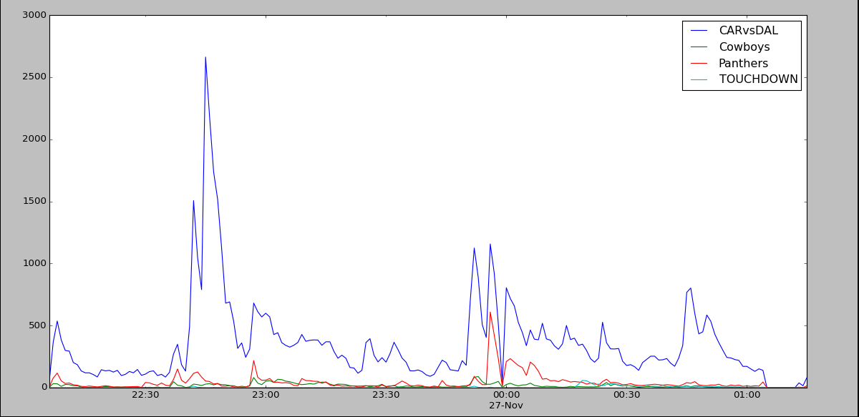
Outputs Continued
Time Series Chart of Tweets per Keyword
Clearly Panthers seems to have more fans than Cowboys for this game
"Dab Newton scores.\n\nDab Newton dances. #CARvsDAL \n\n https://t.co/mrM8xLdfZh",
"Don't test him!! \n\nAnother interception for #LUUUUKE! #CARvsDAL https://t.co/E8AEn8Uc6N",
Cowboys lost the Game

Slide 11
References
http://www.eecs.berkeley.edu/Pubs/TechRpts/2012/EECS-2012-259.pdf

